Slide 1
Rahman Ismail Sr. Software Architect
Emerging Devices Classes

Slide 2
Agenda
The ‘U’ in Universal Serial Bus
Where is Storage Headed?
AMPing up the power
USB and Security
Audio & Video Over USB
What next?
Summary

Slide 3

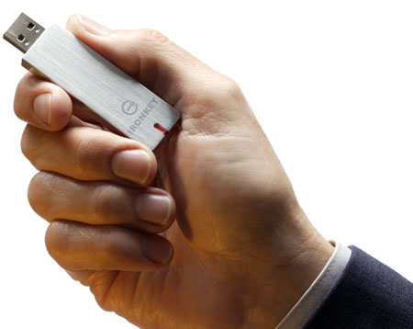
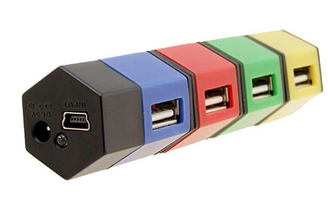
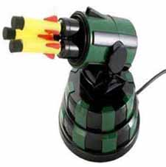

USB: ‘YOU’
3B+ USB devices annual
1B+ Cell Phones annual
150M+ USB Flash Drives annual
Supported on every OS
Present in ever increasing number of cars and embedded systems
Virtually every CE device has USB
3

Slide 4
USB: Ubiquitous
Hid / Input
Cell phone
Personal Storage
Optical Storage
Printers
Scanners
Networks
Smartcard
Biometric
Digital Still cameras
Bluetooth
3G
WinUSB
Video
Audio
USB
Human Interface Devices
Storage
Printers/Scanners
Networking
WAN, PAN, WIFI
Smartcards & Biometric
Cellphone
Digital Still cameras
Audio/Video
Battery Charging
USB: It’s every where ‘U’ go!
4
Notes:
4

Slide 5
Agenda
The ‘U’ in Universal Serial Bus
Where is Storage Headed?
AMPing up the power
USB and Security
Audio & Video Over USB
What next?
Summary
5

Slide 6
UASP - Why A New Protocol?
USB 1.1 completed in 1998
BOT (Bulk-Only Transport) completed in 1999
Designed to support USB 1.1 throughput ~ parallel port
Devices were mainly Flash dongles, Floppy drives, and CD-ROM drives
USB 2.0 completed in 2000
BOT not updated
Speed/capacity ratio allowed larger devices
Devices continue to speed up
USB 3.0 completed in 2008
Speed/capacity ratio now allows much larger devices including RAID
BOT protocol limits full bus utilization
New protocol is needed
6

Slide 7
UAS Development Goals
Address system limitations due to protocol overhead
Enable maximum asynchronous processing
Increase the efficiency of devices
Allow queuing
Enable Task Management to support management of many commands
Enable device command and control capabilities using today’s standards
SPC-4, SBC-3, and SAM-5
Existing performance driver stacks
7

Slide 8
USB 3.0 BOT and UASP
Bulk-Only Transport (BOT) – Legacy USB
High software overhead
Single threaded Commands
USB Attached SCSI Protocol (UASP) – USB3
Minimal software overhead (a la SATA)
Command Queuing and out of order completions
No SW intervention of SCSI command phases
BOT
UASP
BOT Class Driver
UASP Driver
Software
Hardware
Cmd1
Data1
Stat1
Cmd2
…
Cmd1
Data1
Stat1
Cmd2
Data3
Stat3
Cmd3
Data2
Stat2
BOT software overhead eliminated by UASP
8
Notes:
UASP was developed by Intel Labs.

Slide 9
Agenda
The ‘U’ in Universal Serial Bus
Where is Storage Headed?
AMPing up the power
USB and Security
Audio & Video Over USB
What next?
Summary
9

Slide 10

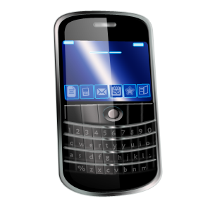
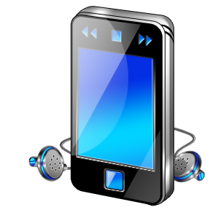


USB Power Delivery Taking a Great Idea …
Broad international adoption of USB Battery Charging standard for mobile devices
China, Europe drove standardization as a means to increase charger reuse and reduce electronic waste
2.5W
4.5W
7.5W
Agreement reached on Micro-USB connector and the standard for the common mobile charger
CENELEC and the USB Implementers Forum reach agreement on memorandum of understanding
BRUSSELS – March 1, 2011– A Memorandum of Understanding (MoU) was signed today between the USB-IF and CENELEC, the European Committee for Electrotechnical Standardization.
USB 2.0
USB 3.0
USB BC 1.2

Slide 11



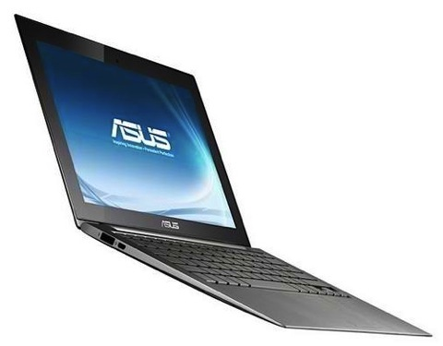
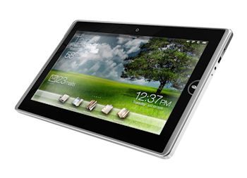
USB Power Delivery …Making it Even Better
HDD
SSD
2.5W
4.5W
7.5W
65W
100W
USB 2.0
USB 3.0
Extend ease of use, reduce clutter, reduce even more waste
USB BC 1.2
USB Power Delivery
11

Slide 12

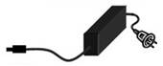

USB Display Docking Example
Display is power source and hub to hosts/devices connected to it
Phone or notebook is USB host driving display and other USB features within or attached to the display
← Power Delivery
← USB Data →
Power Delivery →
HDD
← USB Data →
12

Slide 13
USB Display Docking Example
Display is power source and hub to hosts/devices connected to it
Phone or notebook is USB host driving display and other USB features within or attached to the display
← Power Delivery
← USB Data →
← Power Delivery
Power Delivery →
HDD
← USB Data →
← USB Data →

Slide 14
USB Power Delivery Key Characteristics
Compatible with existing USB 2.0 and USB 3.0 cables and connectors
Enables voltage and current values to be negotiated over the USB power pins
Enables higher voltage and current in order to deliver power up to 100W
Limits to match cable capabilities
Switchable source of power delivery without changing cable direction
Coexists with USB Battery Charging 1.2

Slide 15
USB Power Delivery Requirements
Focus Area | Requirements
Compatibility and coexistence | Work equally well with USB 2.0 and USB 3.0 Coexists with On-The-Go and battery charging operations Minimize issues with non-compliant cabling, e.g. limit higher voltage use to known cables
Power | Existing cables: up to 7.5W PD-aware cables: up to 100W
Negotiation | Over VBUS only, no data line usage or reliance
Start-up | Legacy 5V VBUS start, voltage / current adjust after negotiation Start recovery mechanism for host or device dead battery conditions
Policy | Default policies built-in for hardware-only starts Software interface enables more advanced policies
User experience | Expose power delivery status to OS Support features to eliminate silent failures

Slide 16
USB Power Delivery Profiles
Source capabilities organized as profiles
PROFILE 0
5V @ up to 1.5A
0 – 7.5W Default start-up profile – Usage with existing cables remains here
PROFILE 1
5V, 12V, 20V @ 1.5A
0 – 30W
PROFILE 2
5V, 12V, 20V @ 3.0A
0 – 60W
Limit for Micro-B/AB
Requires new detectable
cables
PROFILE 3
5V, 12V, 20V @ 5.0A
0 – 100W
Limit for Standard A/B
Additional capabilities possible as optional extensions to standard profiles

Slide 17
USB Power Delivery Architecture
Provider
Consumer
Device Policy Engine
Device Policy Engine
Source Port
Sink Port
Policy Engine
Power Source(s)
Power Sink
Policy Engine
Protocol
Protocol
Cable Detection
Cable Detection
Physical Layer
Physical Layer
USB Port
USB Port
ID pin/pads
Shield
VBUS
VBUS
Shield
ID pin/pads
VBUS
ID pin/pads
ID pin/pads
Shield

Slide 18
Agenda
The ‘U’ in Universal Serial Bus
Where is Storage Headed?
AMPing up the power
USB and Security
Audio & Video Over USB
What next?
Summary
18

Slide 19
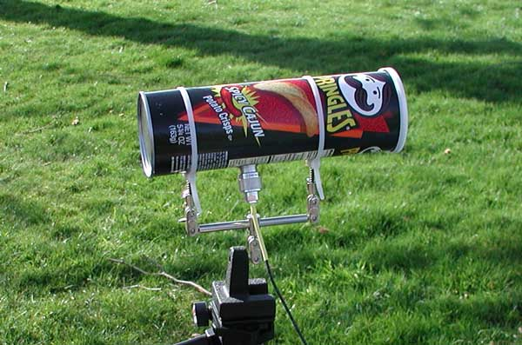
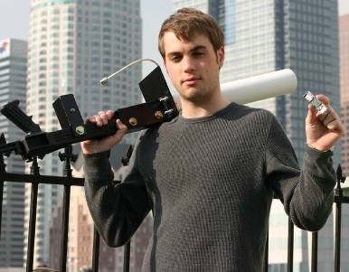
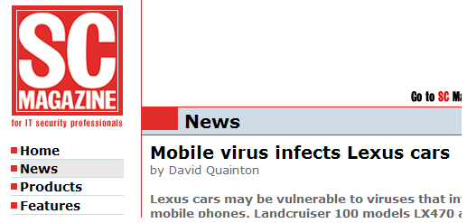
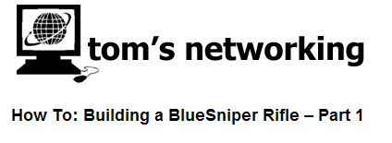
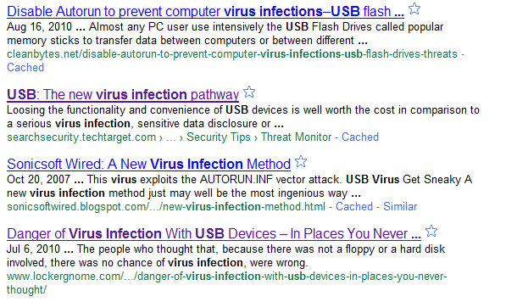

Why Security Matters?
Bluetooth
19

Slide 20
Objectives for a Security Class
Certificate based
Certificates issued by a certification authority
Mutual Authentication
Device accepts system and/or system accepts device
Key generated during this step may be used for encryption
Balance cost, complexity, latency, power versus robustness
Acceptable for usage in Finance, Health care, Corporate and Government Environments
Scalable constraint roadmap
Initially simple constraints, later a richer constraint system
Host to device security
Hubs are transparent
20

Slide 21
Typical Device Enumeration
21

Slide 22
Secure Device Enumeration
22

Slide 23
Agenda
The ‘U’ in Universal Serial Bus
Where is Storage Headed?
AMPing up the power
USB and Security
Audio & Video Over USB
What next?
Summary
23

Slide 24
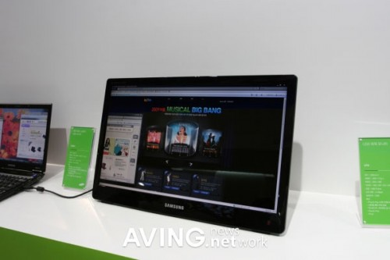
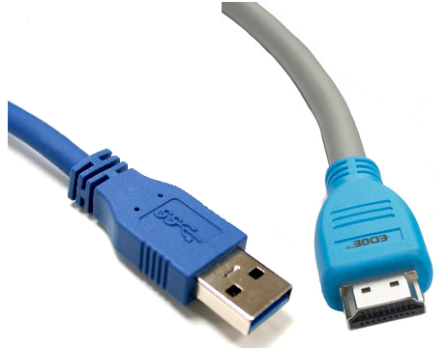
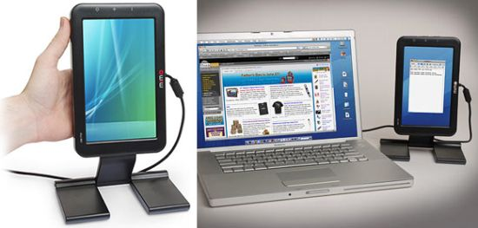
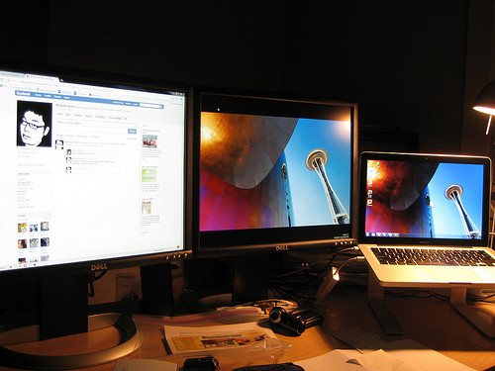


Additional Display for PC Clients
Secondary and multiple display productivity
multi-media applications
(USB3 to HDMI/DP)
24

Slide 25
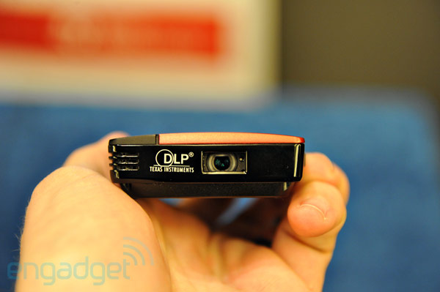
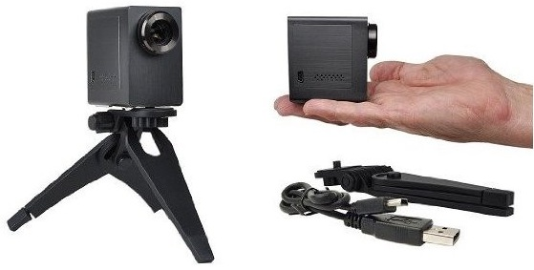
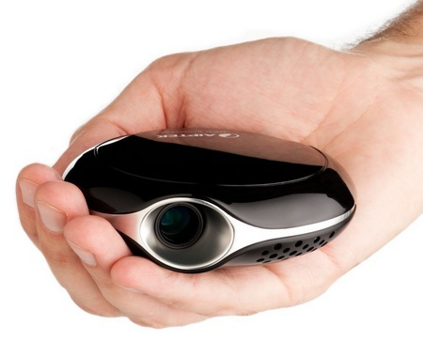
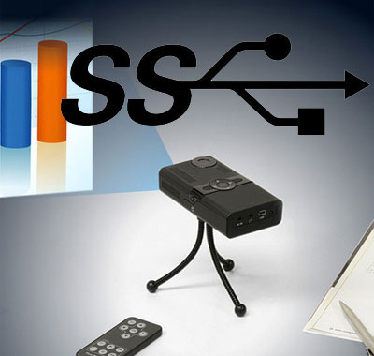
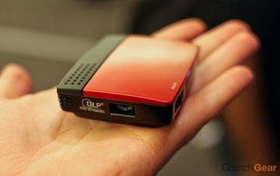
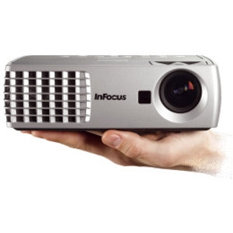
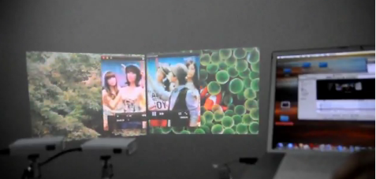
Pico Projectors
Secondary and multiple display productivity
multi-media applications
25

Slide 26
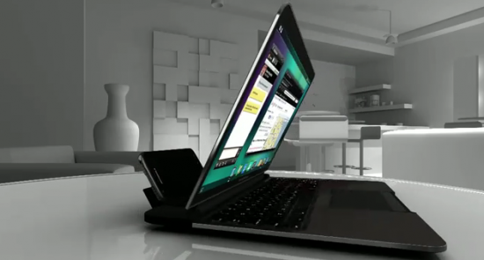
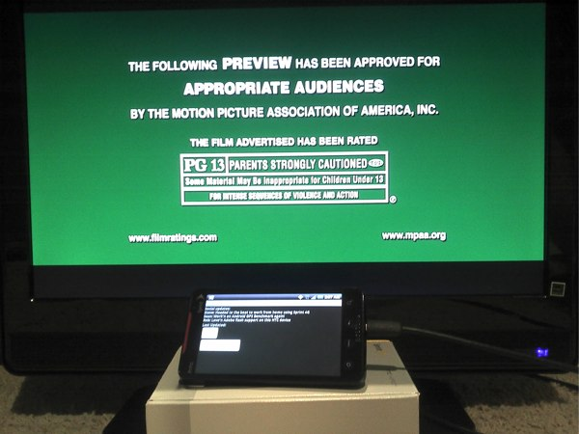
Handheld Use Cases
HDMI has drawbacks for HH
With HDMI phone needs to supply power to display
Supporting both HDMI and USB directly impacts Industrial design.
Micro-USB must-have for sync & charging
USB 3.0 micro-AB ramp in 2013 compounds the connector problem
Two connectors on a dock is kludgy
USB 3.0 with AV enables a single converged connector on the phone for display, charging, Sync, Debug
HH for “Productivity”
HH to TV (including protected content)
26

Slide 27
Why AV Over USB?
One USB connector and cable
Replaces all the audio and video connectors and cables
Is used for battery charging
Can be used for debug and firmware upgrades
USB can transfer control information bi-directionally between the source and the sink
For example, it is possible to control the projector in the ceiling from a Smartphone
USB supports simultaneous content streaming bi-directionally
Cost:
USB is present in all PCs, so no additional hardware is required
No transport-related fees
USB connectors and cables are inexpensive
27

Slide 28
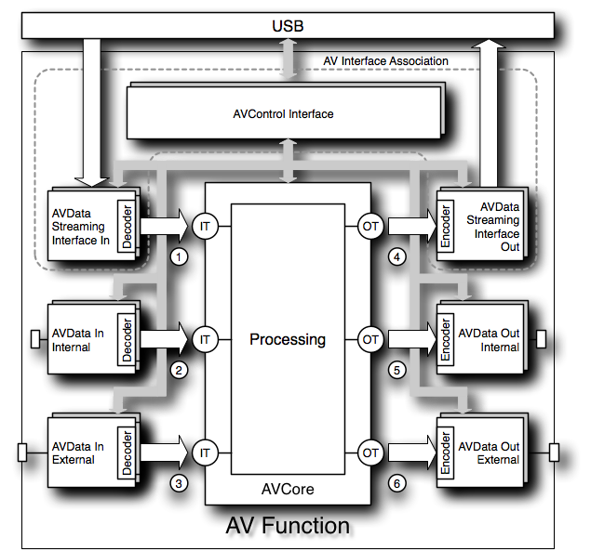
AV Core Spec – Overview
Architecture of AVFunction
AV Core
AV Interface Collection
AV Entities
Abstract Model of AV Core
Units & Terminals
AV Cluster
AV Description Document
XML Format
Unit Description
Entity Description

Slide 29
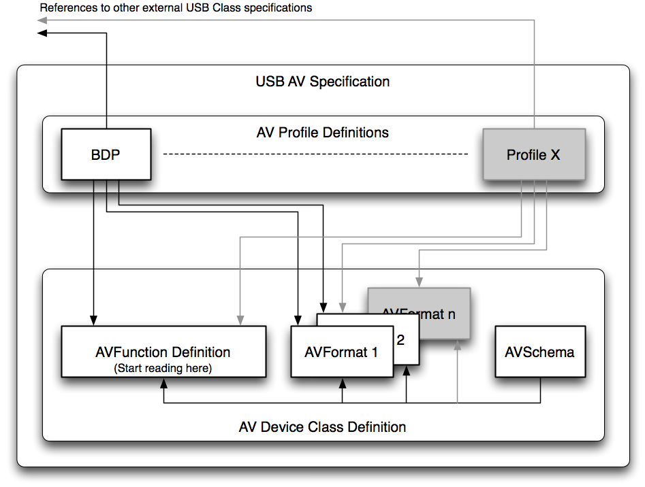
Spec Organization

Slide 30
Profiles
AV specification is extremely rich
Designed to support virtually any conceivable USB AV Function
Requiring support for all possible AV features in all possible software stacks is not realistic
Define well-bounded subsets of the AV specification that serve a certain class of use cases
Subsets are called Profiles
Based on and fully compliant with the AV specification
Require only those building blocks and features that are necessary to implement the use cases
Bring in components of other USB Device Classes to create more of Ex: Many use cases require some form of HID functionality

Slide 31
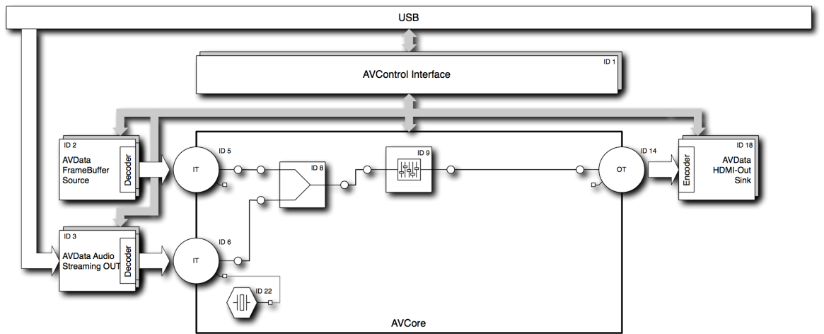
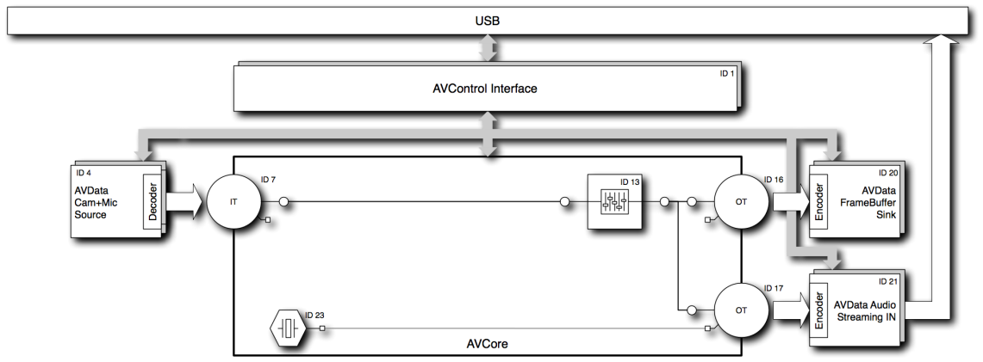
Profiles (Cont’d)
Profile that supports display-related devices
Simple PC monitor (Device) hooked up to a PC or cell phone dock (Host)
Profile that supports (web)cam-related devices
Ex: Cell phone (Device) plugged into a TV or car head unit (Host)
Phone runs a local app that generates AV content
Host simply retrieves that AV content from the phone

Slide 32
Agenda
The ‘U’ in Universal Serial Bus
Where is Storage Headed?
AMPing up the power
USB and Security
Audio & Video Over USB
What next?
Summary
32

Slide 33
What Next?
Wireless USB Take 2
Remote Peripheral Connectivity Technology
Seam-less peripheral sharing across platforms (mobile phone & PCs)
Wireless docking station for various IA platforms
A connector-less platform vision
Re-use built-in OS USB Class drivers to enable existing application software works without any changes
Enhanced Connectivity
Comprehend today’s complex devices
Create a “just works” environment
Use on all USB technologies (Full Speed, High Speed, SuperSpeed, Wireless)
Backwards compatibility

Slide 34
Call To Action
Download the latest specifications
Updated USB 3.0 specification with all errata
Use the tools on usb.org to aid in device development
Join the workgroups on usb.org
34

Slide 35
Summary
SuperSpeed USB is here, it’s real
USB AV class: the next step
It’s all about Power!
USB is truly ‘Universal’!
Infinite Possibilities!
35
Notes:
35

